Slide 1

Trance
An Installation

Slide 2
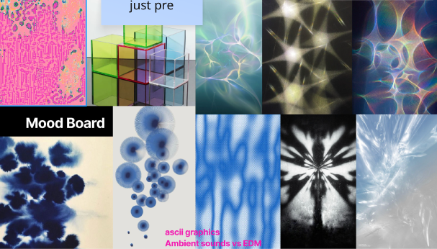




Intro
What is it?
Interactive audio‑visual installation
Clear acrylic hand plate with lights and pressure sensor
Your touch controls what you see and hear
p5js mockup

Slide 3
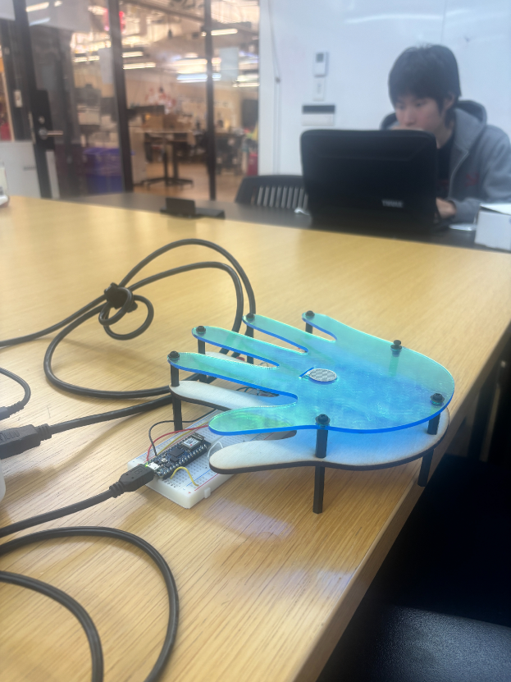
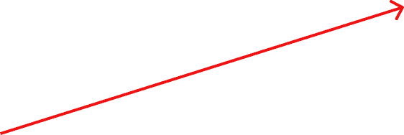
How is it hypercinema?
This project is hyper cinema because time and structure come from the audience, not from a fixed timeline. There is a clear beginning with a short video, a middle where your pressure shapes everything, and an end when you let go and the system slowly comes down. The narrative arc is defined by how long you stay and how you interact
Time comes from your presence and actions
Beginning: intro video
Middle: your pressure drives the experience
End: release, fade, and return to calm
fsr
p5js

Slide 4
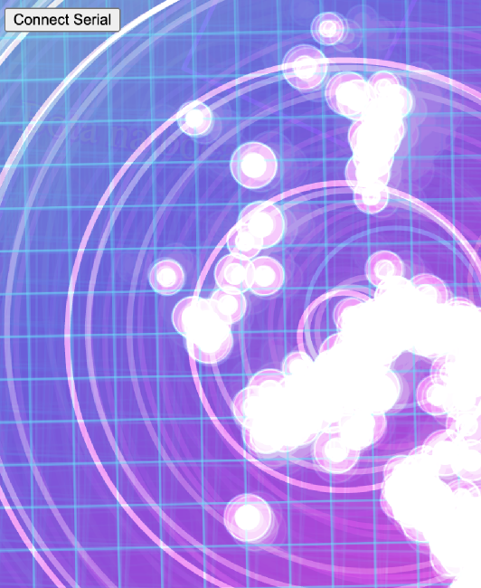
Intro
Why trance?
Music trance: the beat pulls you in
Focus trance: you get locked into the interaction
Visual trance: hypnotic light and patterns
It’s about the feeling of getting lost in music and losing track of time.
link

Slide 5
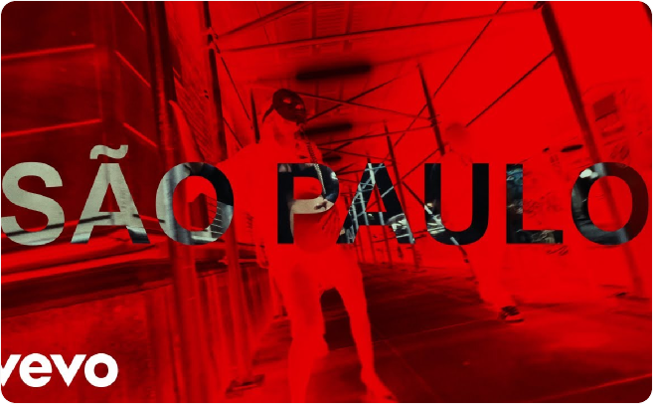
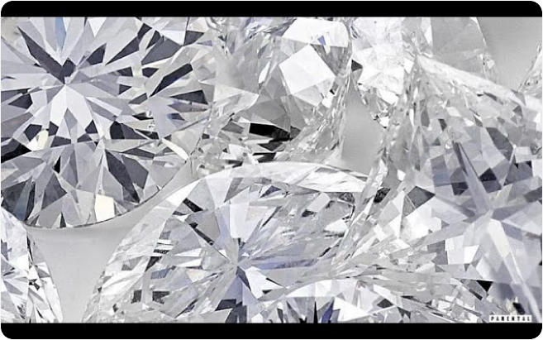
Concept: From Surface to Transformation
The concept moves from surface to transformation. The intro video uses ‘Diamonds Dancing. The interactive part shifts into ‘São Paulo’ by The Weeknd, a track that represents a turning point and a feeling of rebirth. The installation follows that same path, from what is shown on the surface to what is felt inside.

Slide 6
Concept
What I Want the Audience to Feel
Music as something you feel, not just hear
Your body and touch shape the experience
You are not just a viewer; you are a participant
Your pressure changes the visuals in front of you. You’re not just watching a piece of media; you’re actively performing with it

Slide 7
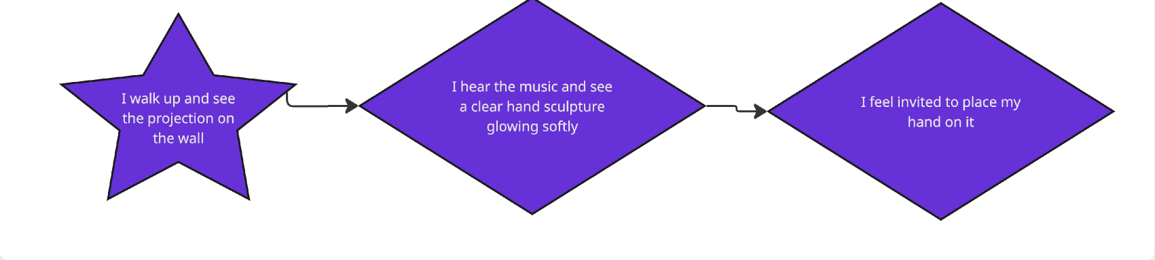
Concept
User Journey: First Person
As a viewer, I walk up and see a short video playing on the wall, with ‘Diamonds Dancing’ setting the mood. There’s a clear acrylic hand sculpture in front of me with subtle lights, almost like it’s waiting. The video and visuals invite me to place my hand on the sculpture

Slide 8
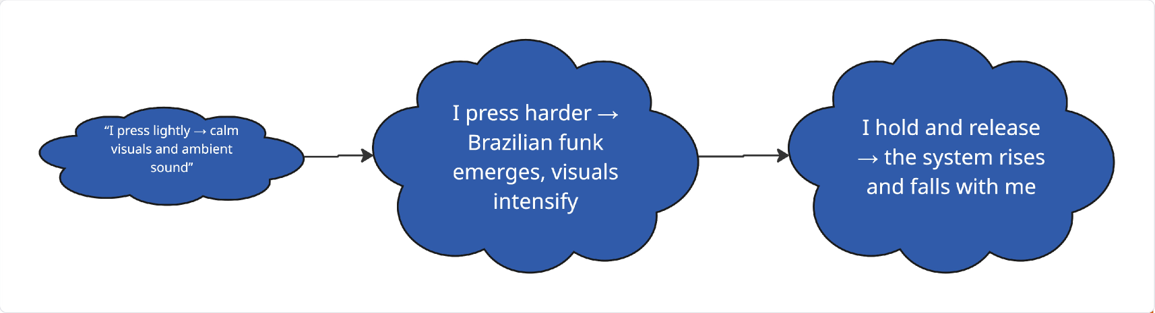
Concept
User Journey: The Interaction
When I press lightly, I hear calm, ambient sound and see soft, gentle visuals. When I press harder, the Brazilian funk parts of ‘São Paulo’ start to cut through, and the visuals become brighter and more complex. The longer and harder I press, the more intense everything feels. When I release, the system slowly settles back down and breathes out with me

Slide 9
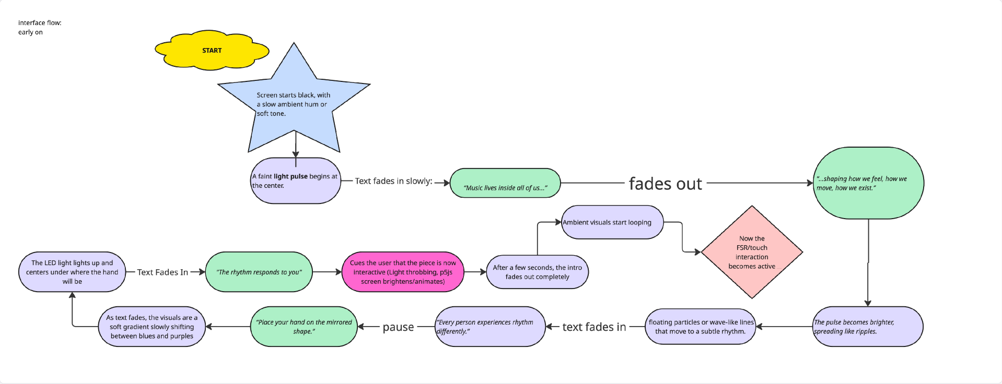
Progress
On-Screen Flow: Video Intro

Slide 10
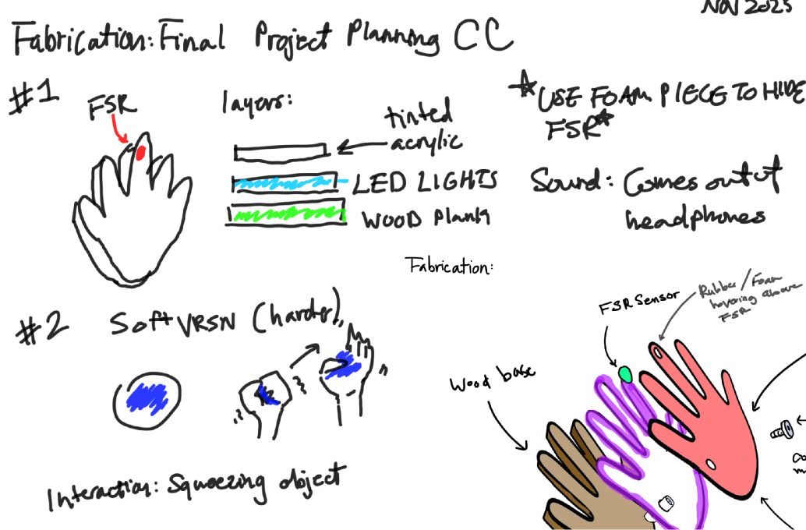
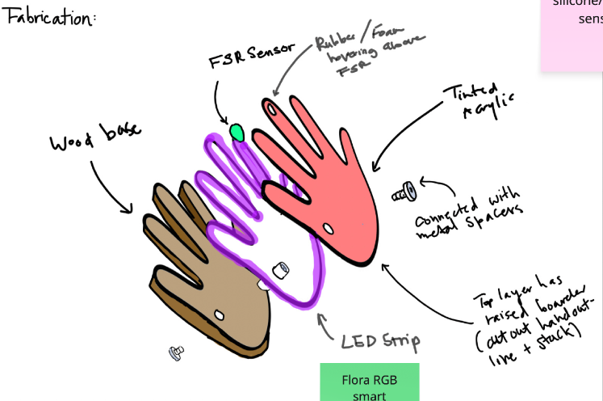
Progress
Fabrication

Slide 11
Tech
Tech Overview
Pressure sensor (FSR) in the hand sculpture
Arduino reads pressure and sends it to the computer
p5.js controls visuals and audio mix
LEDs reflect intensity on the sculpture
Inside the hand sculpture there’s a force‑sensitive resistor that measures how hard you press. An Arduino reads that data and sends it to a computer. In p5.js, that sensor data controls both the visuals on the wall and the mix between ambient sound and ‘São Paulo.’ The LEDs in the sculpture also change based on intensity, so the object itself feels alive

Slide 12
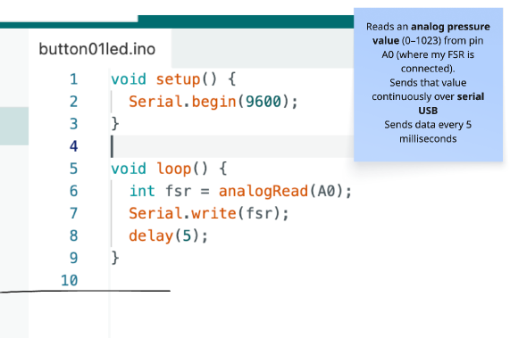
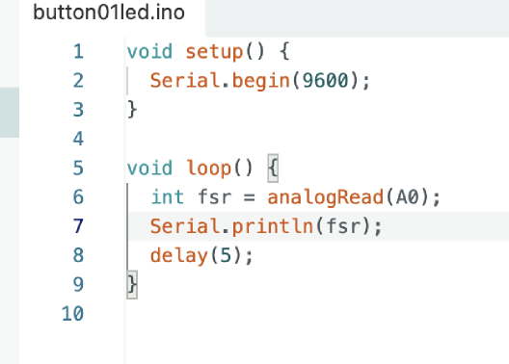
Tech
Tech Overview
miro

Slide 13
Tech
Skills used from class
p5.js for generative visuals and sound transitions
Web serial communication between Arduino and browser
Sensor mapping: pressure → light, color, sound energy
Physical fabrication: Soldering, lazer cutting, projection
Templates from Creative Computing
This piece pulls together several skills from the semester of communications Lab and Creative Computing. p5.js drives the visuals and audio transitions. Web serial connects the Arduino and the browser. Sensor mapping translates pressure into changes in color, brightness, and sound energy. On the fabrication side, there’s the layered acrylic hand, the hidden sensor and LEDs, and the way the surface is designed to feel like an object you want to touch.

Slide 14
Tech
Fixing the Arduino + p5.js Connection
Serial data was inconsistent, fragmented, or not printing at all
Ports wouldn’t appear or refused to open in the browser
Older WebSerial libraries caused freezes + undefined variables
FSR values merged together (ex: “324335412” instead of single readings)
p5.js visuals received NaN, causing the canvas to not draw
Audio couldn’t start because it depended on valid sensor input
Fix: simplified Arduino output + rebuilt WebSerial system
The Arduino and p5.js connection kept breaking because the serial data was inconsistent, merged, or not printing at all. Ports wouldn’t open, older WebSerial libraries froze, and p5.js kept receiving invalid values that broke the visuals and audio. I fixed this by simplifying the Arduino output to one clean reading and rebuilding the serial system with P5SerialLite, which stabilized the data flow and made the interaction responsive and intentional
Notes:
One of the biggest challenges of the whole project was getting the Arduino and p5.js to actually talk to each other in a clean, stable way. At first, the serial data was a mess. Sometimes the Arduino printed the FSR values too fast, or printed extra text, or didn’t print anything at all. Because of that, p5.js kept receiving broken strings or merged numbers. I’d get huge unreadable values like ‘3252991283’ instead of one pressure reading. And when p5 gets invalid data, it immediately breaks the visuals and turns everything into NaN. On top of that, the browser wouldn’t always show the port, or it would open once and then completely freeze. The older WebSerial libraries I tried either crashed, didn’t buffer the data correctly, or threw errors like ‘Cannot access before initialization.’ So even if the Arduino was sending data, the browser wouldn’t actually deliver it to the sketch. Those two issues together meant the canvas wouldn’t draw, the audio wouldn’t start, and the whole interaction felt dead. What finally solved everything was going back to the basics on the Arduino side — printing only one clean value per line — and then rebuilding the entire serial layer in p5.js with P5SerialLite. It gave me a proper Connect button, clean callbacks, and a buffered line reader so the FSR data never breaks or merges. Once the connection stabilized, everything else — the visuals, the movement, the audio — started working instantly. That was the moment the project finally came alive

Slide 15
Tech
Visual Design and Aesthetic Choices
Ambient state: soft gradients, slow movement, low saturation
Intense state: tunnel effects, kaleidoscopes, glitchy motion
Color shifts tied to pressure and song energy
Connected an FSR to Arduino and sent one clean pressure value at a time.
Used WebSerial in p5.js to read that value without glitches.
Mapped the sensor data into a usable pressure level for visuals.
Designed full-screen, psychedelic animations that react to pressure.
Light pressure created calm movement; heavy pressure created chaotic motion.
Fixed earlier serial issues by simplifying Arduino output and stabilizing p5.js parsing.
Built a smooth, responsive interaction between the robot and the visuals.

Slide 16
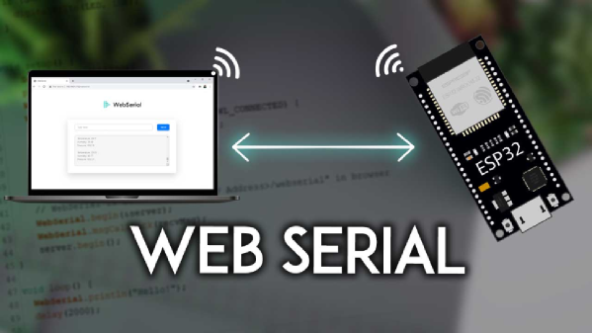
Tech
Web Serial: Connecting the Body
Web Serial lets my browser talk directly to the Arduino over USB.
The Arduino sends live pressure data from the sensor into my p5.js sketch.
This turns my hand pressure into a continuous data stream that drives visuals and sound.
Web Serial is what connects the physical side of this project to the digital side. The Arduino reads the force sensor and sends those values straight into the browser, in real time. That live stream of numbers is what lets my hand pressure directly reshape the visuals and the music instead of playing a pre-rendered video.

Slide 17
Tech
Web Serial: What I Learned
Modern Web Serial APIs change quickly and required troubleshooting.
I had to manage port states, errors, and reconnects, not just happy paths.
Working through that taught me how fragile live interactive systems can be, and how to design around that.
Working with Web Serial was a big learning curve. Libraries changed, browser behavior changed, and ports would fail or stay open. Dealing with that forced me to think about robustness: what happens if the connection drops, how to recover, and how to still give the user a smooth experience. That is part of the invisible work behind the piece.
Creds. To Dan O’Sullivan

Slide 18
UX
Arc: Beginning, Middle, End
Start quiet intro and invitation to interact
Middle transformation driven by your pressure
End release, dissolve, and gentle reset

Slide 19
UX
Interaction Design Decisions
No complicated instructions: video and gesture show what to do
Pressure levels mapped to clear states (light, medium, hard)
LEDs confirm that it’s responding to you
One design goal was to make it obvious what to do without a lot of text, and this is something that really helped through user testing. The video and the hand shape are enough to suggest ‘place your hand here.’ Pressure is mapped to three recognizable states so people can quickly understand the relationship between their touch and the response. LEDs and motion act as confirmation that the sculpture is listening to them

Slide 20
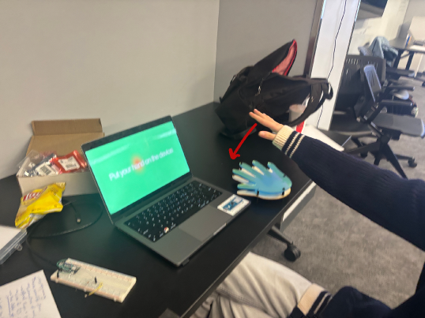
UX
After Feedback - week 1
Users understood “put your hand here” instantly
They wanted more feedback from the hand itself
Added stronger LED responses and planned future haptics
User: Jessica
During user testing, everyone understood immediately that they should place their hand on the sculpture, which was good. But many people wanted more direct feedback from the hand itself. They expected it to glow or react more dramatically when they pressed. That led to stronger LED patterns tied directly to pressure and ideas for future haptic feedback, like subtle vibration
user test

Slide 21
Takeaways
Challenges and What I learnt
Web serial and browser changes made connection tricky
Managing sensor noise and mapping smooth pressure curves
Balancing visual chaos with clarity and legibility
One major challenge was dealing with serial communication changes in the browser. Some libraries were outdated, and connecting reliably to the Arduino took extra work. I also had to smooth the sensor data so tiny fluctuations didn’t cause jittery visuals. Another lesson was about balance: it’s tempting to make everything explode with energy, but the piece is stronger when chaos is anchored by clear, readable states

Slide 22
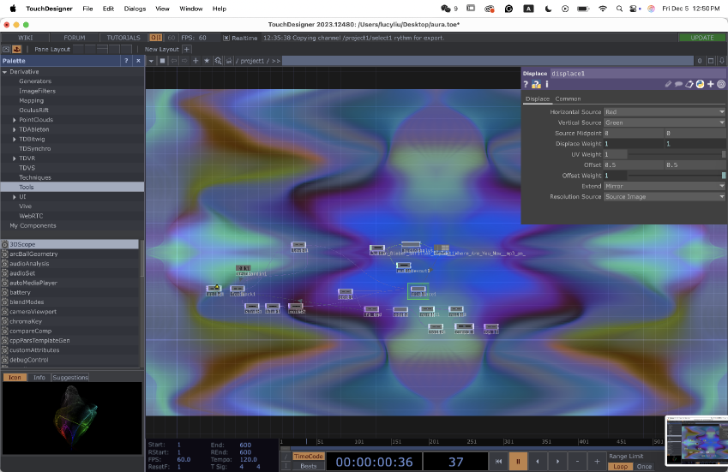
Takeaways
Where I Want to Take It Next
Add subtle vibration to the hand for deeper feedback
Refine light “breathing” when idle to invite people in
Explore multi‑user or longer‑form versions for exhibitions
Touch Designer

Slide 23
Takeaways
What I Hope You Take Away
Music can be something you perform with your body
Simple gestures can unlock emotional, cinematic experiences
You are part of the artwork every time you touch it
The main thing I hope people take away is that music can be something you perform through your body, not just something you listen to. A simple gesture like pressing your hand can open up a full emotional and cinematic experience. Every person who touches the sculpture changes the piece a little, and that makes the audience part of the artwork

Slide 24




Future, & Drake. (2015). Diamonds Dancing
Song
The Weeknd. (2024). São Paulo
Song
p5.js. (n.d.). p5.js Reference
Neeti Creative Computing
Web Serial API. (n.d.). Web Serial API documentation
Dan O
ChatGPT
Debugging and Testing
Notes:
CITATIONS: Creative computing week 2, 3, 11, 12 slideshows. Yuliya and Dan'O for coding help, debugging and connected my fsr and p5js when it wasnt working. Andre for fabrication help answering questions i had and picking a prototype out of the ones I couldn't chose. Along with Daniel Shiffman, we debugged this code and used chatgpt. I used used it to rewrite the code for p5js, along with test this code I used the potentiometer template and made ai combine the two templates they provided me as the link chatgpt gave me in HTML file was not compatible with my computer.

